Slide 2
Unit 4: Arrays and Strings (6hrs)
Introduction to arrays
One-dimensional and Multidimensional arrays
Initialization of arrays and accessing the elements of arrays
Strings- the character arrays
Functions related to the strings

Slide 3
Character I/O statements
Character is any symbol that we give to the computer through the keyboard.
We use getchar() and putchar() for character input and output purpose.
Statement | Purpose | Syntax | Example
getchar() | used to enter character from keyboard. | Variable=getchar(); | lett=getchar(); where lett is a variable.
putchar() | used to display character on the screen. | putchar( variable or character); | putchar (lett); putchar(‘A’);

Slide 4
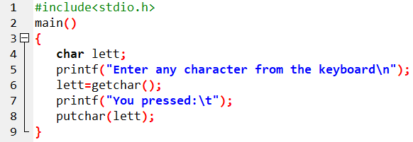
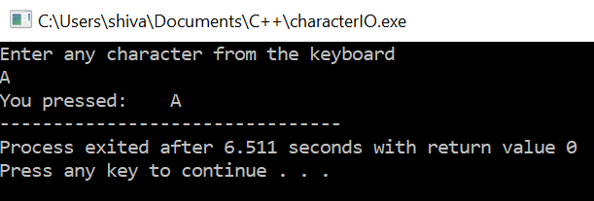
Prog. 11: WAP to enter a character and display it using character I/O statements.

Slide 5
Strings
array of characters (i.e. character array is known as string).
A string is a sequence of characters that is treated as a single data item.
A string is always terminated by a NULL character (i.e. \0).
Syntax for declaring strings:
char stringName [size];
Eg:
char name[20];

Slide 6
Strings
Compile-time initialization of string:
Strings can be initialized as:
char name[]= [‘R’, ‘A’, ‘M’, ‘\0’];
or, we equivalently can write as:
char name[]= “RAM”;
Run-time initialization of string:
Strings can be initialized as:
char name[20];
gets(name);

Slide 7
String I/O statement
The gets() and puts() are used for input and output of strings.
Statements | Purpose | Syntax | Example
gets() | It reads a string from keyboard. | gets( variable name); | gets( name); where name is a variable.
puts() | It displays string on display. | puts( variable name or string data); | puts (name); puts(“RAM”);

Slide 8
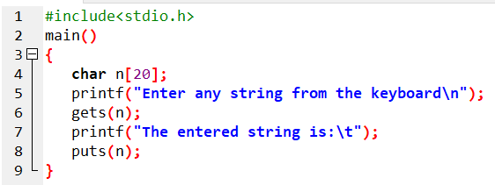
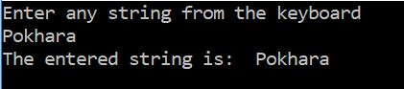
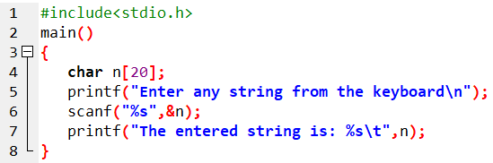
Prog. 12: WAP to enter any string from keyboard and display it using string I/O statements.
OR

Slide 9
String Handling Functions
Inbuilt functions defined in <string.h>
Used to manipulate string data.
strlen() | Returns the length of the string
2. strcpy() | Copies the content of one string into another string
3. strcat() | Joins two strings
4. strrev() | Returns the string in reverse order
5. strlwr() | Changes the characters of string in lower case
6. strupr() | Changes the characters of string in upper case
7. strcmp() | Compare two strings

Slide 10
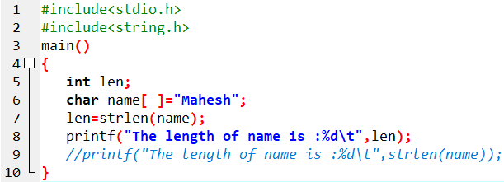
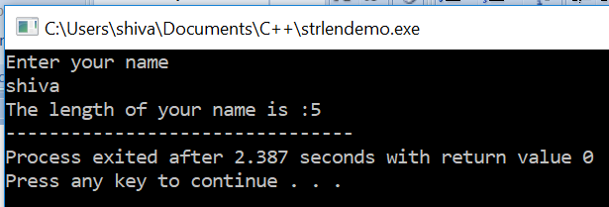
Prog. 13: WAP to initialize a string and display its length.

Slide 11
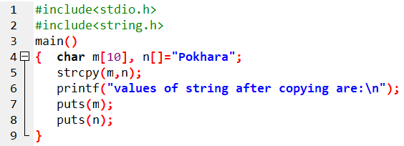
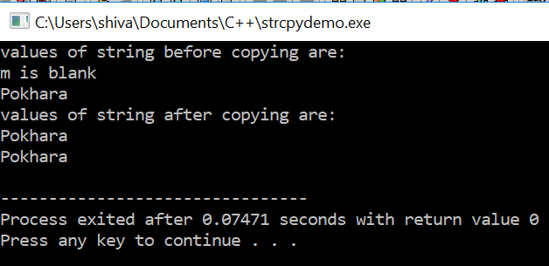
Prog. 14: WAP to demonstrate the use of strcpy().
Here, content
of n copied
to m

Slide 12
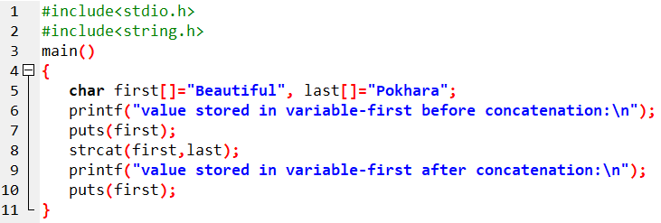
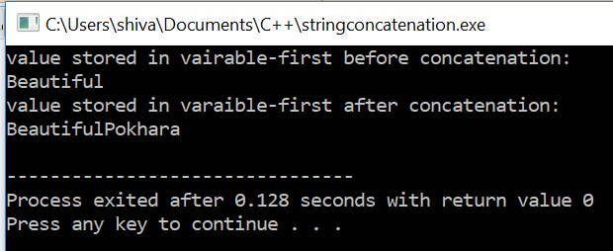
Prog. 15: WAP to concatenate a string to another string.
Here, content
of last is
concatenated
to first

Slide 13
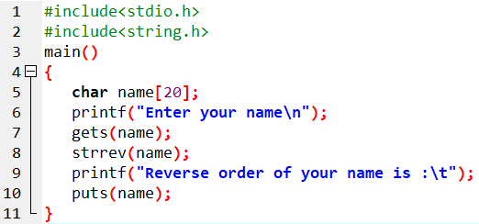
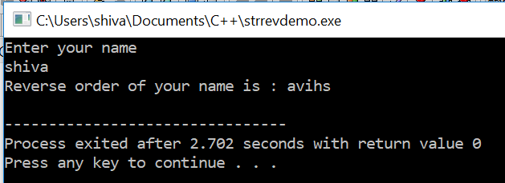
Prog. 16: WAP to reverse an input string using strrev()

Slide 14
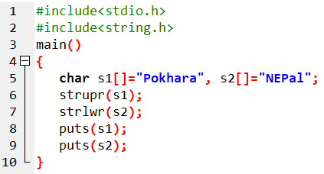
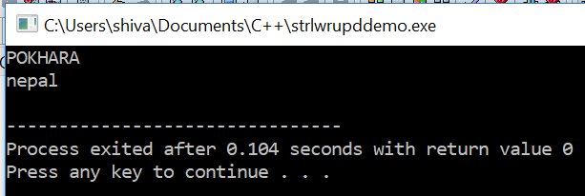
Prog. 17: WAP to change the case of strings.

Slide 15
String comparison
strcmp() is used for string comparison.
Compared as per dictionary case.
Actually, ASCII value of characters taken and then compared.
A-Z -> 65-90
a-z -> 97-122
0-9 -> 48-57
If :
First string > Second string -> 1
First string < Second string -> -1
First string = Second string -> 0

Slide 16
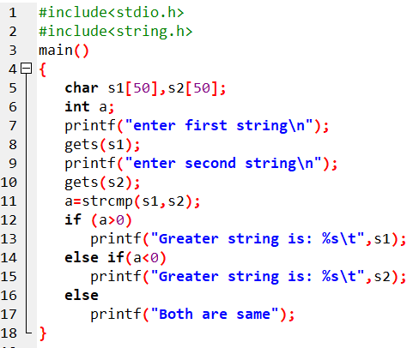
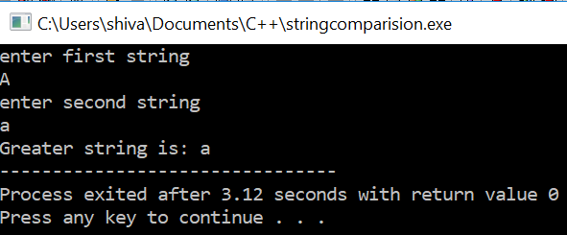
Prog. 18: WAP to compare two input strings.
If the inputs are Aa and aa : output is Greater is aa
If the inputs are ram and ramesh, output is Greater is ramesh.
If the inputs are ram and rajesh, output is Greater is ram.
If the inputs are apple and apple, output is Both are same

Slide 17
4.7 Array of String
An array of strings is a 2-D array of character of character.
So, 2-D character array can be used to store list of name’s string.
Eg: char name[5][30];
This may be used to store a list of 5 names each of maximum length of 30 characters.

Slide 18
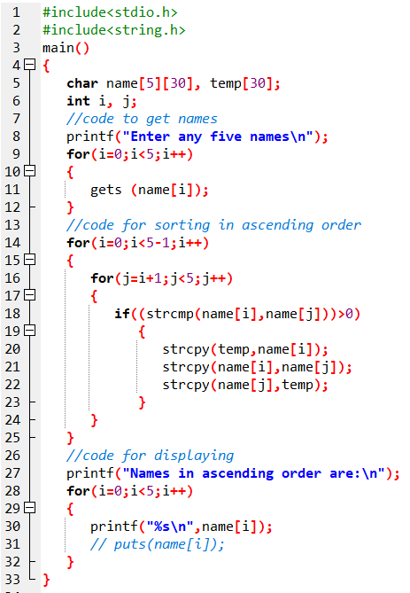
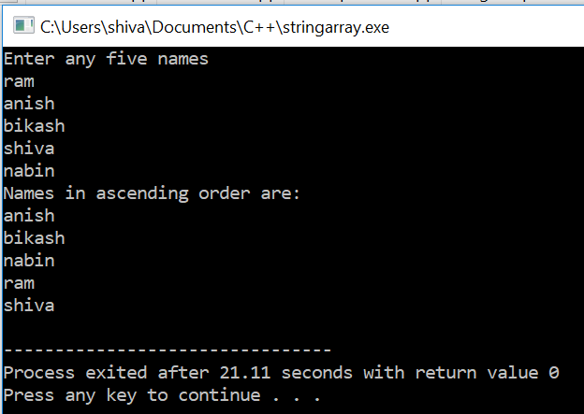
Prog. 19: WAP to read names of 5 persons and sort in ascending order, i.e. alphabetical order.

Slide 19
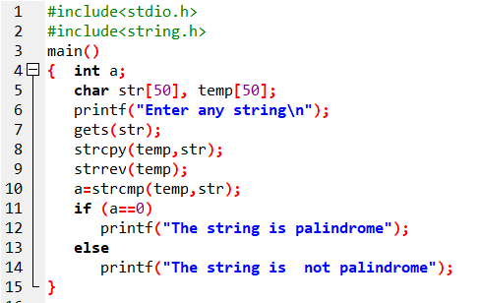
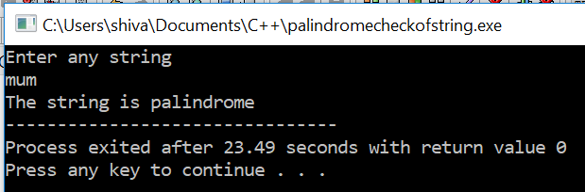
Prog. 20: WAP to input a string and check if it is palindrome.

Slide 20
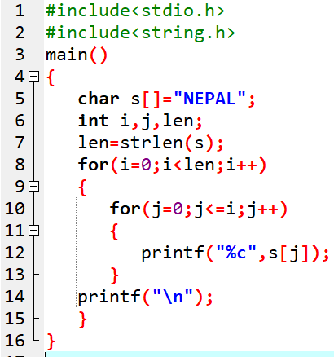

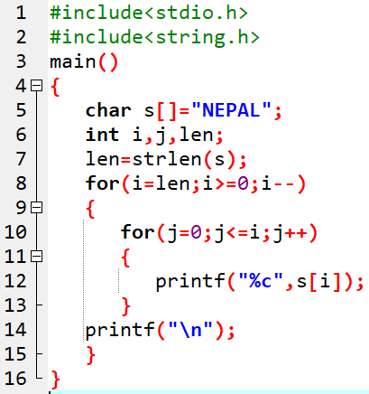

Prog. 21: WAP to display NEPAL as:

Slide 21
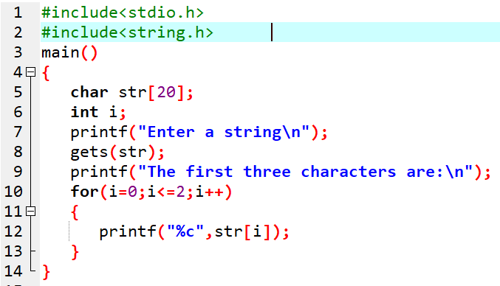
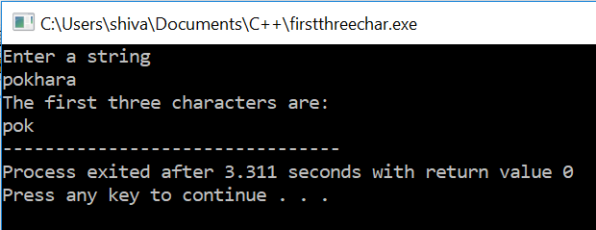
Prog. 22: WAP to take out only the first three characters from the entered string.

Slide 22
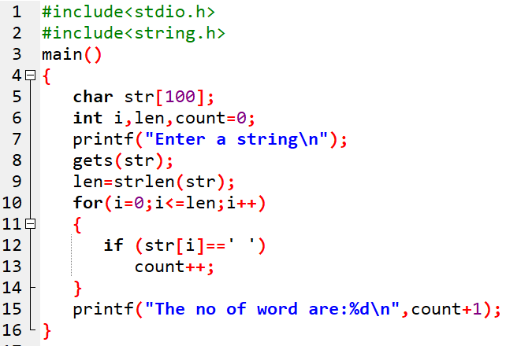
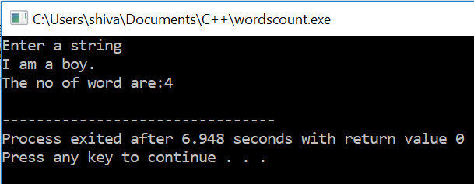
Prog. 23: WAP to enter a sentence (i.e. string) and count out the number of words in it.

Slide 23
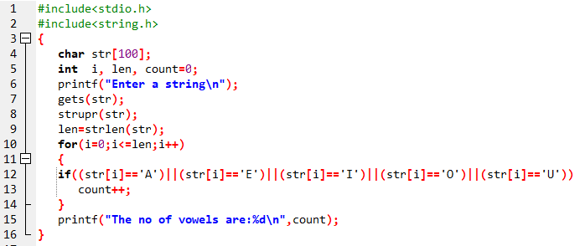
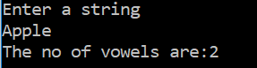
Prog. 24: WAP to enter a string and count the number of vowels present in it.

Slide 24
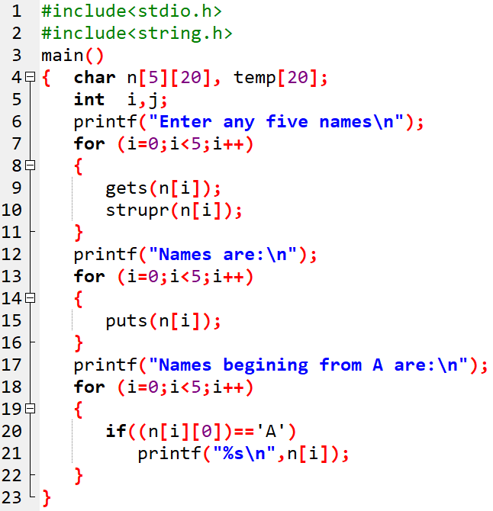
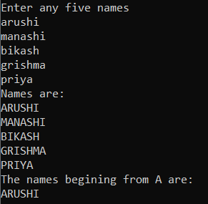
Prog. 25: WAP to enter any five names and display only the names that begins from A.

Slide 25
Assignment 3:
WAP to input any five names and sort them in ascending order.
WAP to input any five names and sort them in descending order.
WAP, using array, to input any 10 numbers and display only the prime numbers from there.

Slide 26
End of Lecture 10

Slide 27
Functions

